Slide 1
Cybersecurity
Shoulder Surfing

Slide 2
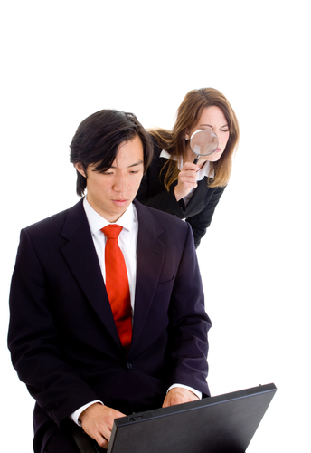
Shoulder Surfing
You possess information
Others want it
Why?
Curiosity
Industrial espionage
Competitive advantage
Easy in public places
Coffee shops, libraries, airports
Hallway-facing monitors
Surf from a distance
Binoculars/telescopes
Remote webcams

Slide 3
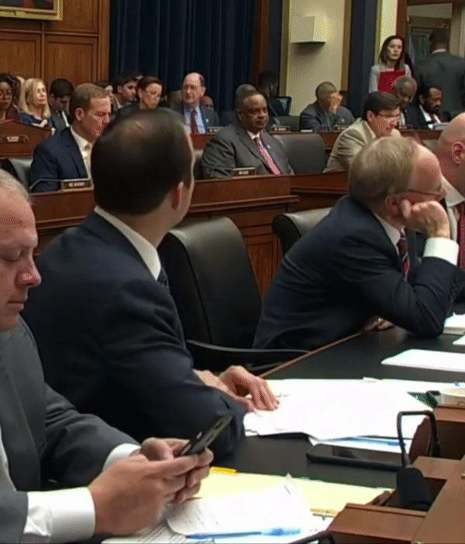
What’s his passcode?
Congressman Lance Gooden (TX-5) on CSPAN coverage of House Financial Services Committee, 2019

Slide 4
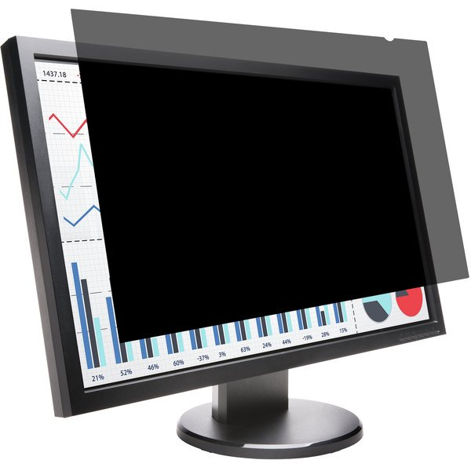
Preventing Shoulder Surfing
Be aware of your surroundings
Privacy screen
Keep monitor facing away from windows and hallways

